Slide 1
Synergy Application
Submitted By,
A V Aswin
Vimal P Viswan

Slide 2
Problem Statement
To provide a solution that comprises of the appropriate cloud services, any other tools/software/services if necessary service is not available in the cloud, while taking into consideration these requirements:

Slide 3
Continues..
Provide a web portal to the user.
Synergy application which needs to have a private and a public subnet.
Should include a Load Balancer in the public subnet along with the security group.
Two Web Servers.

Slide 4
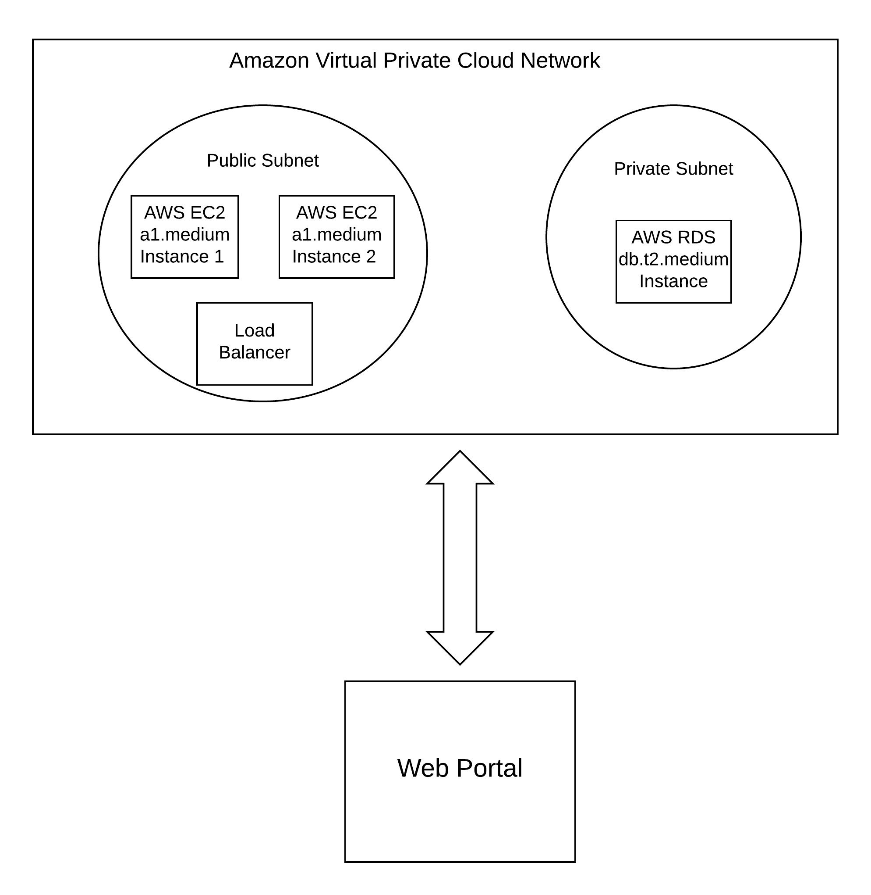
Architecture Diagram

Slide 5
Technical Background
AWS EC2 :
Amazon Elastic Compute Cloud (Amazon EC2) is a web service that provides secure, resizable compute capacity in the cloud. It is designed to make web-scale cloud computing easier for developers.
AWS RDS :
Amazon Relational Database Service is a distributed relational database service by Amazon Web Services.

Slide 6
Continues...
3. Amazon Aurora :
Amazon Aurora is a MySQL and PostgreSQL-compatible relational database built for the cloud, that combines the performance and availability of traditional enterprise databases with the simplicity and cost-effectiveness of open source databases.

Slide 7
Continues...
4. AWS VPC :
A virtual private cloud (VPC) is a virtual network dedicated to your AWS account. It is logically isolated from other virtual networks in the AWS Cloud.
5. AWS SDK for JavaScript in Node.js :
The SDK helps take the complexity out of coding by providing JavaScript objects for AWS services including Amazon S3, Amazon EC2, DynamoDB, and Amazon SWF

Slide 8
Continues...
6. AngularJS :
AngularJS is a JavaScript-based open-source front-end web application framework mainly maintained by Google and by a community of individuals and corporations to address many of the challenges encountered in developing single-page applications.

Slide 9
Continues...
7. NodeJS :
Node.js is an open-source, cross-platform JavaScript run-time environment that executes JavaScript code outside of a browser.

Slide 10
AUTOMATING THE START AND STOP OF EC2 INSTANCES
The necessary services other than EC2 for doing this include
Lambda : compute service that lets you run code without worrying about servers
CloudWatch : monitoring service for AWS
IAM : (Identity and Access Management, control security access)

Slide 11
Sequence of Operations to Do this...
Initiate the EC2 instance and follow the given steps.
LAMBDA STOP EC2
Select Lambda from Compute under the services tab.
For starting the first function click on “Author from Scratch”.
For configuring triggers select CloudWatch events and then select click on create new rule.
For adding a new rule select schedule expressions and then specify the time accordingly using the CRON expression.(eg : cron(0 22 * * ? *))
Give the function a name: “EC2InstanceStop”, a description: “EC2 Instance Stop” and for Runtime select “Python 2.7”.

Slide 12
Continues...
LAMBDA STOP EC2 (Continues..)
Then in the Lambda function code section paste this in to stop your EC2 instance:
The program is available at (Replace the instance ID and Region) https://github.com/vimal97/Inframind/blob/master/EC2stop.py
Select “Create a custom role” from the “Lambda function handler and role” section.
In the new window that opens enter “lambda-start-stop-ec2” for Role Name.
Click “View Policy Document” and then “Edit”.
Paste the json in the edit window https://github.com/vimal97/Inframind/blob/master/json.js
Click create function when complete.

Slide 13
Continues...
To create the Start EC2 function click on “Functions” on the left hand side menu and then click “Create function”.
Click “Author from scratch”.
Add the “CloudWatch Events” trigger and select “Create a new rule”. Name it “lambda-start-ec2”. Description: “Lambda Start EC2”
For the CRON expression use “cron(30 12 ? * MON-FRI *)”, enable the trigger and click “Next”. This starts the EC2 instances Mon-Fri at 8:30EST / 12:30UTC.
For the function name use “EC2InstanceStart”, description use “EC2 Instance Start”, Runtime select “Python 2.7” and for the function code enter : https://github.com/vimal97/Inframind/blob/master/EC2start.py

Slide 14
Continues….
Make sure the “Handler” is set to “lambda_function.lambda_handler”.
For “Role” select “Choose an existing role” and from the “Existing role” dropdown select “lambda-start-stop-ec2” that you created earlier.
Under “Advanced settings” set the timeout to 10 seconds.
Click “Create Function”.
Next click the “Code” tab so that we can test the function we have just created.

Slide 15
Necessity of this Automation
Allow instances to run during a specific period.
Only allow employees to work on staging instances within a certain time frame.
Reduce costs.
Prevent instances from loading up during the weekend.

Slide 16
Implementation

Slide 17
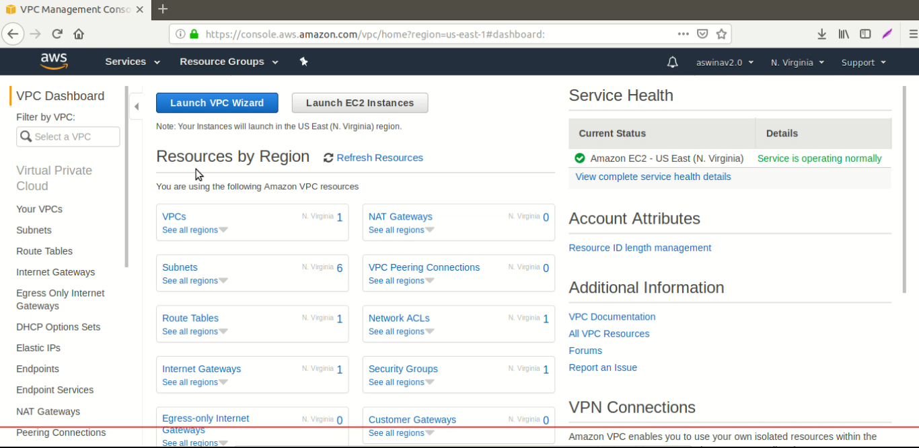

Slide 18
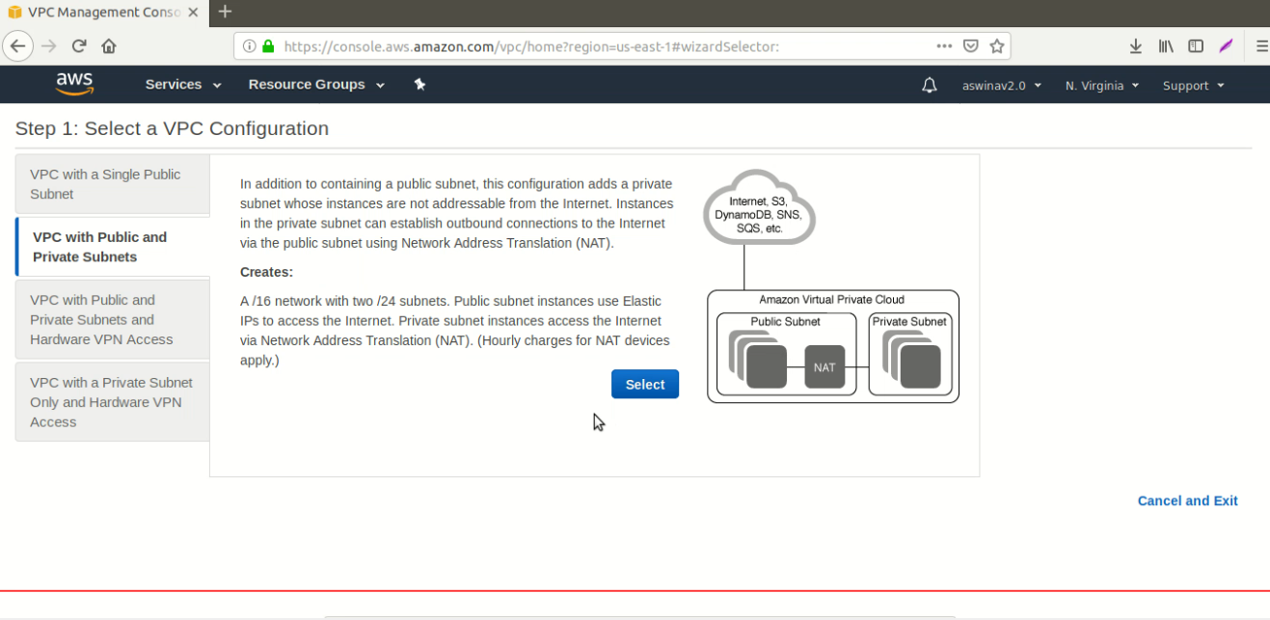

Slide 19
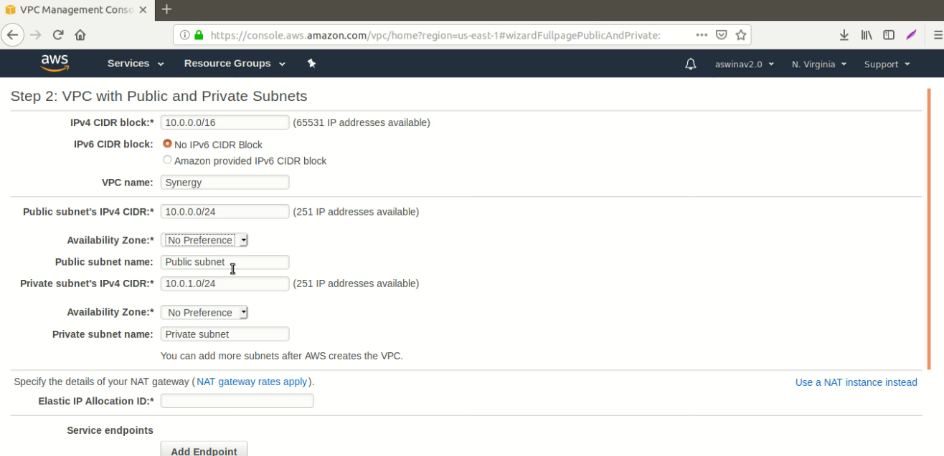

Slide 20
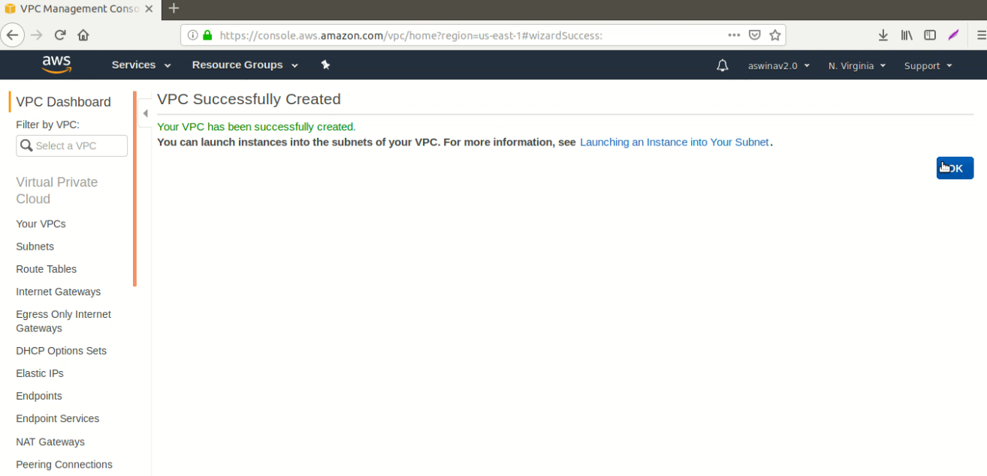

Slide 21
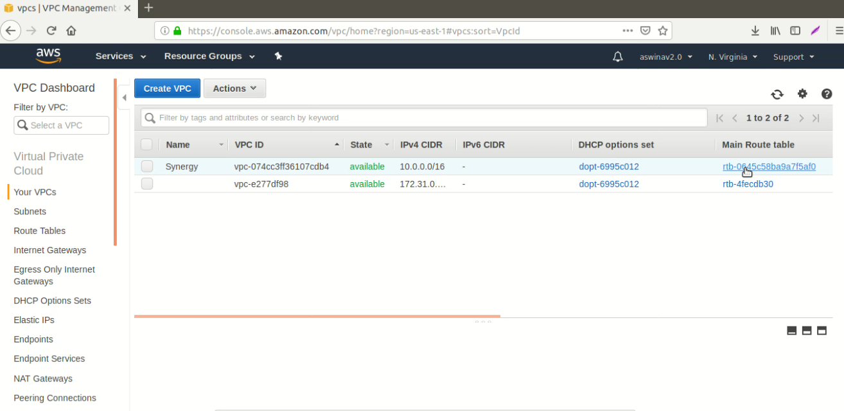

Slide 22
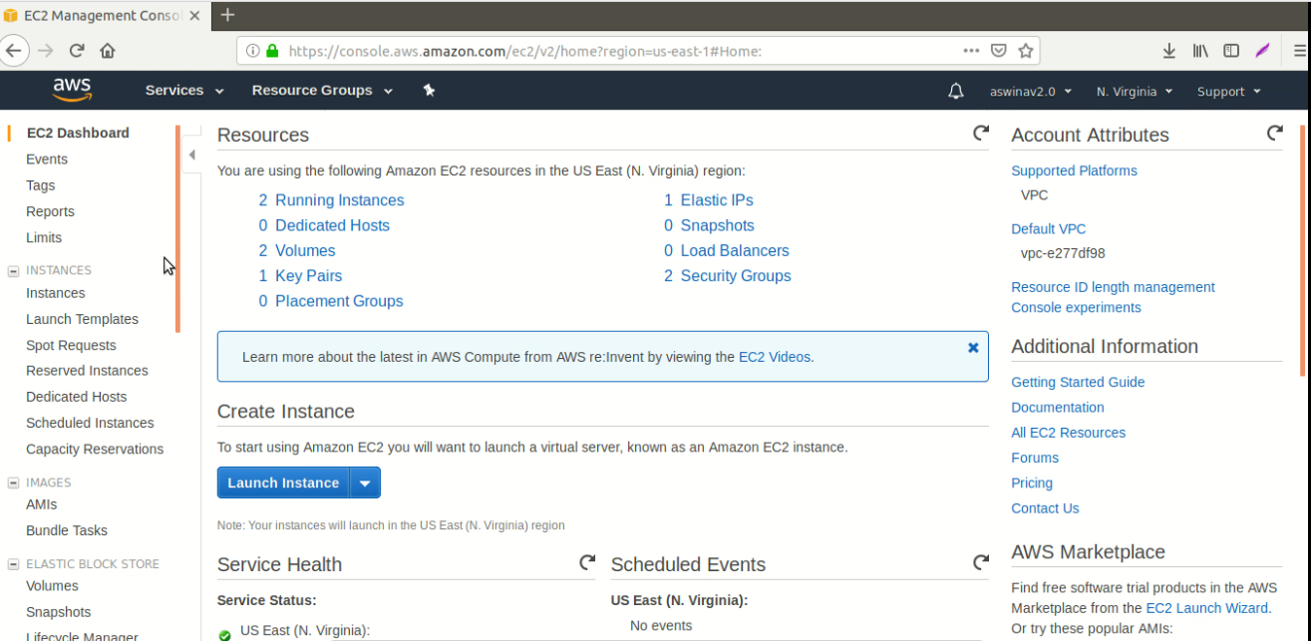

Slide 23
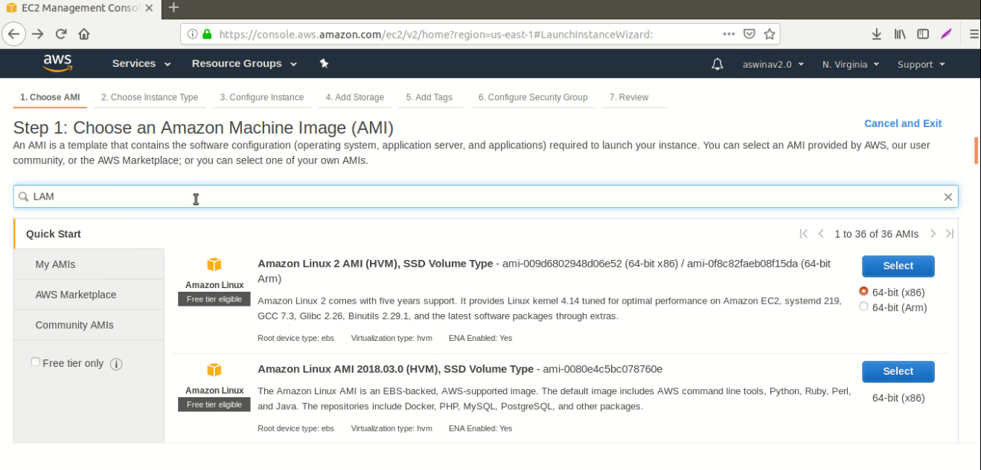

Slide 24
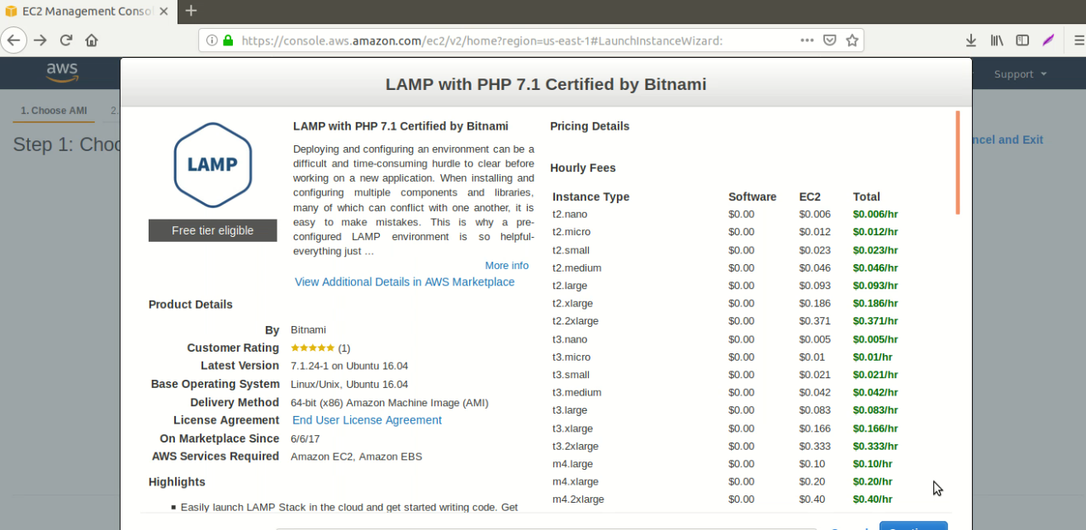

Slide 25
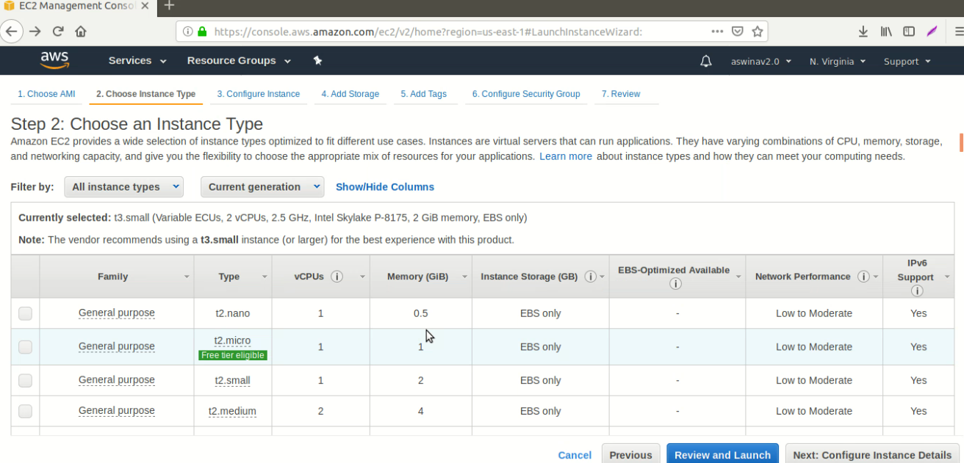

Slide 26
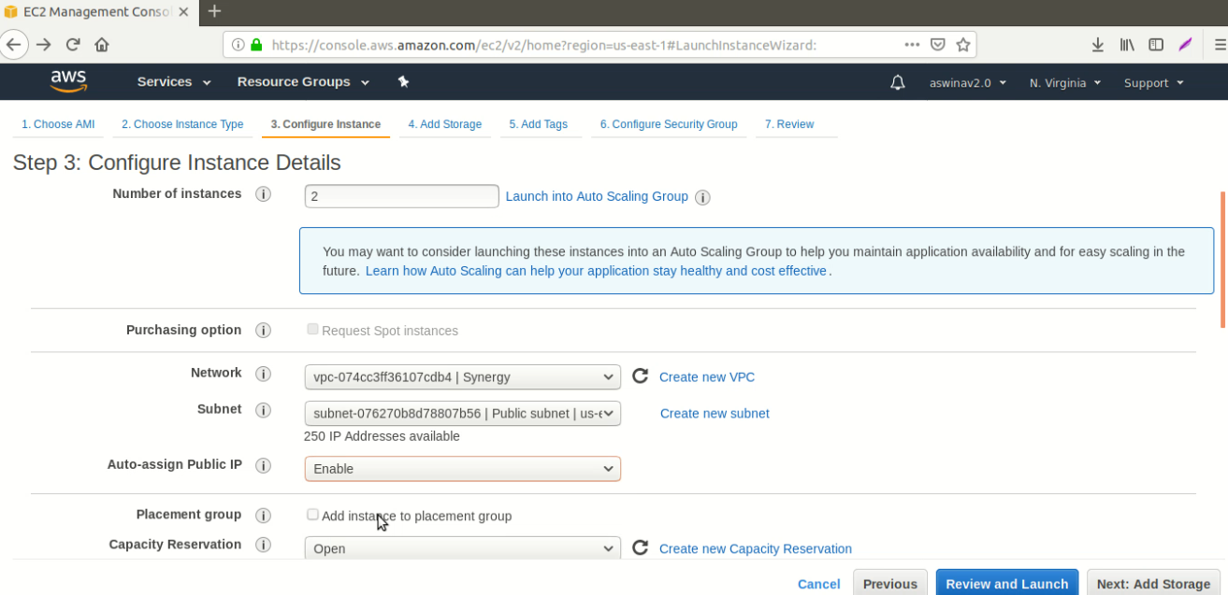

Slide 27
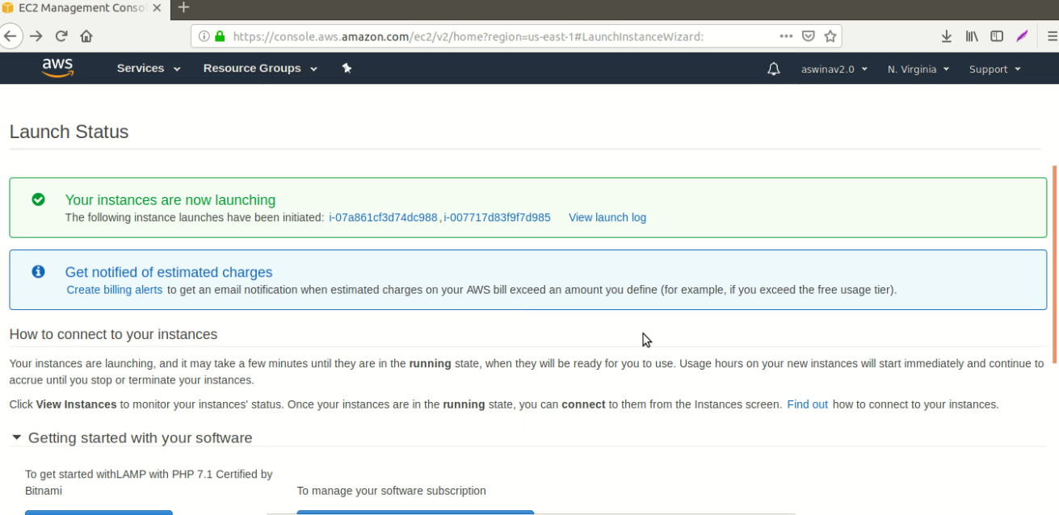

Slide 28
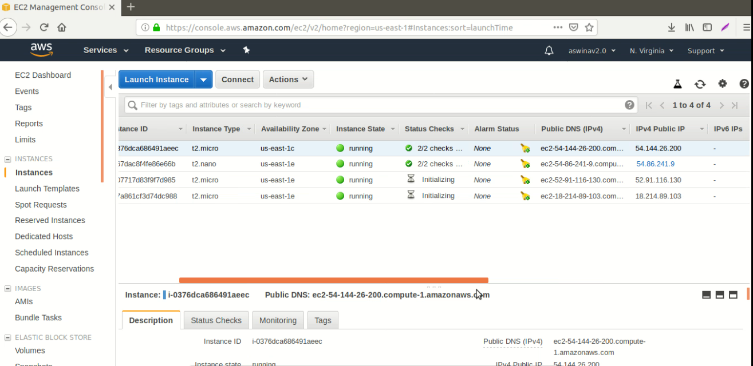

Slide 29
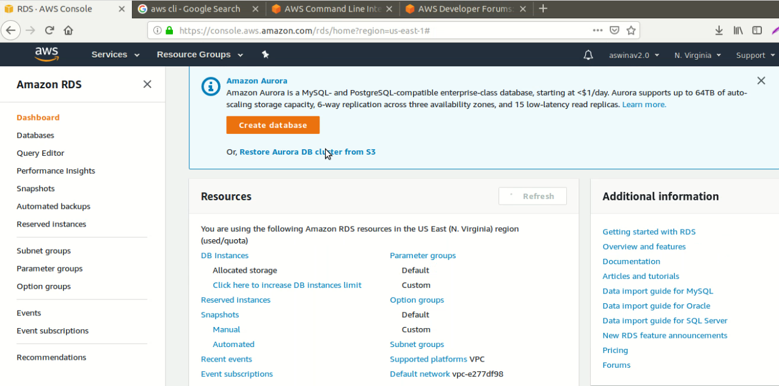

Slide 30
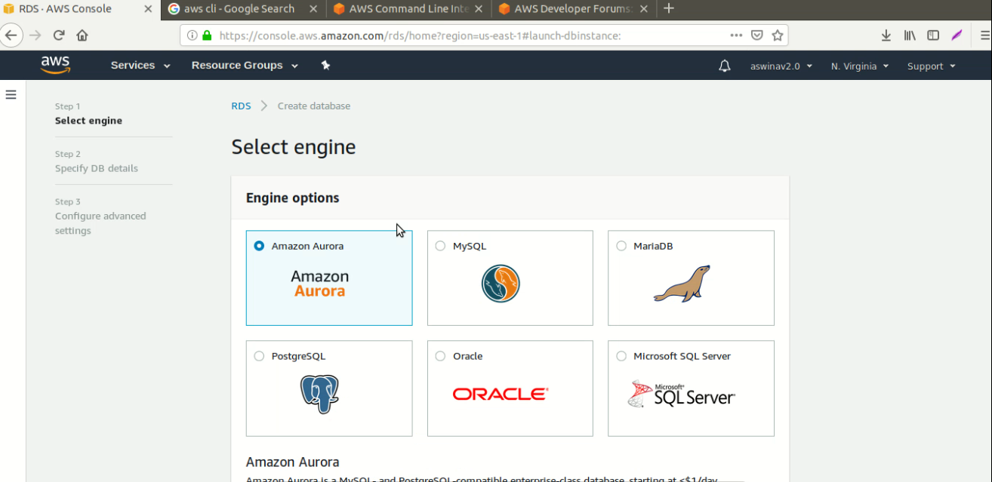

Slide 31
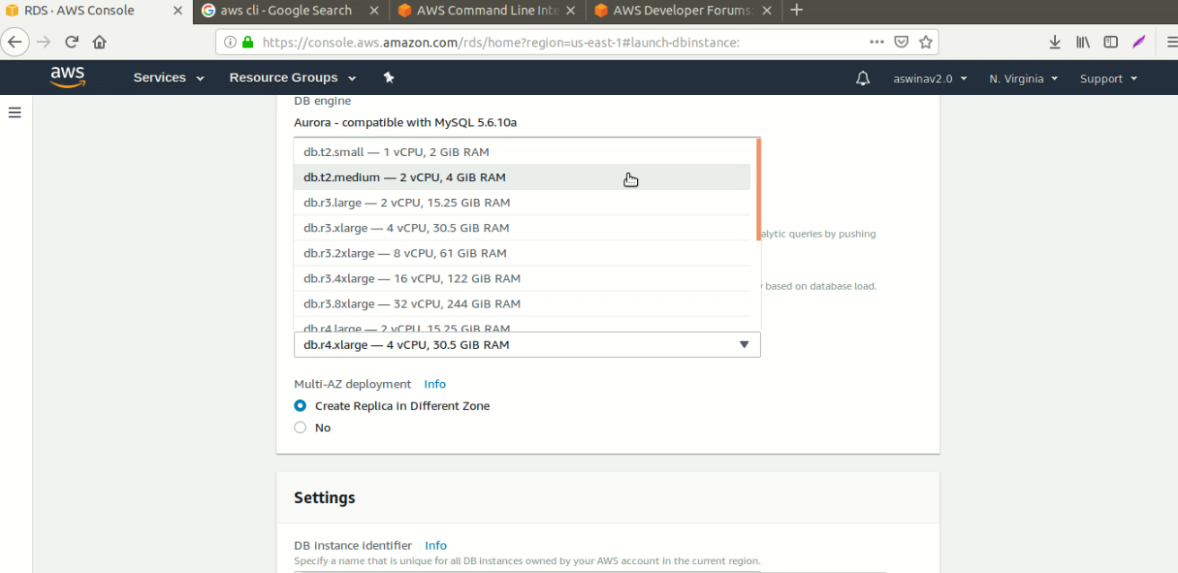

Slide 32
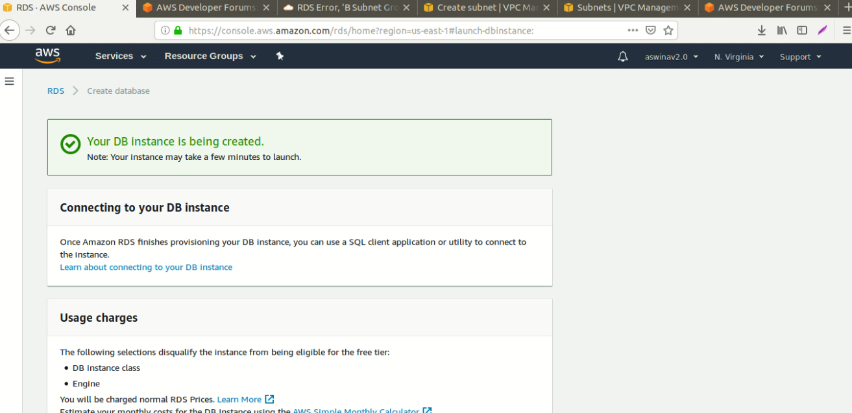

Slide 33
Thank You!

